Slide 1
2014 Volatility Plugin Contest
Dave Lassalle
NolaSec Presentation
11/19/2014

Slide 2
About Me
11 years InfoSec experience
Previous: Raytheon, SPR
Current: GE Capital, Incident Analyst
Incident Response
Forensics
Memory Analysis
Malware Analysis

Slide 3
Volatility/Plugin Contest
Memory Analysis framework
Probably never been to NolaSec if you don’t know what it is
2nd Annual Plugin Contest
“create innovative, interesting, and useful extensions”
Like Hex-Rays IDA Plugin contest
“Simple” plugins
No disassembler, no debugger, no reversing
Only python and a hex editor

Slide 4
Plugins Submitted
Office Trust Records (1)
Java IDX Parser (1)
Firefox (3) and Chrome History (6)
SQLite shared code
SSDeep-based Plugins (3)

Slide 5
Plugins Submitted
Office Trust Records
Java IDX Parser
Firefox and Chrome History
SSDeep-based Plugins

Slide 6
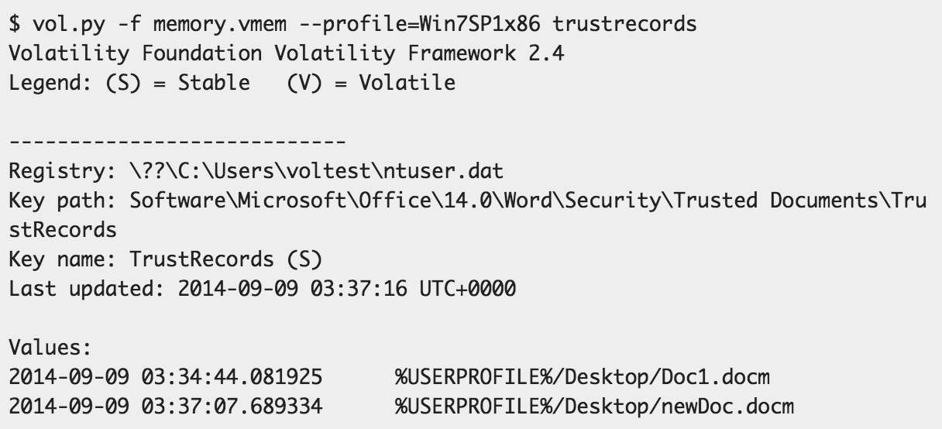
Office Trust Records
Record files opened from an untrusted location and manually “trusted”

Slide 7
Plugins Submitted
Office Trust Records
Java IDX Parser
Firefox and Chrome History
SSDeep-based Plugins

Slide 8
Java IDX Parser
Metadata associated with downloaded JAR
Time, URL, IP, HTTP headers
Locate IDX File in memory with scanner
BusyFlagIncompleteFlagVersionForceUpdate
\x00\x00\x00\x00\x02\x5a\x00 - 602
\x00\x00\x00\x00\x02\x5b\x00 - 603
\x00\x00\x00\x00\x02\x5c\x00 - 604
\x00\x00\x00\x00\x02\x5d\x00 - 605
Run Brian Baskin’s IDX Parser
http://www.ghettoforensics.com/2013/04/java-malware-identification-and-analysis.html

Slide 9
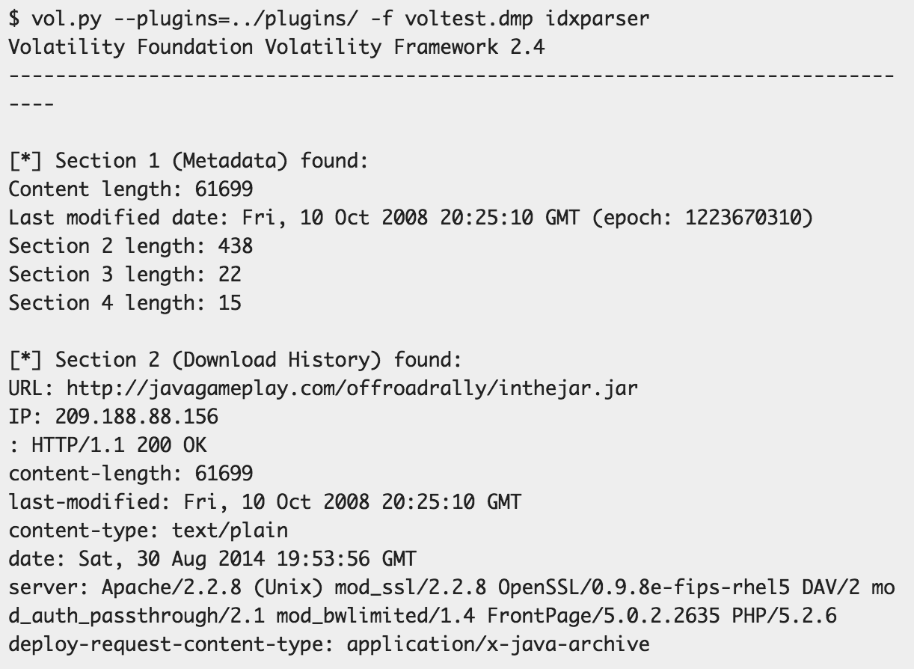
Java IDX Parser

Slide 10
Plugins Submitted
Office Trust Records
Java IDX Parser
Firefox and Chrome History
SSDeep-based Plugins

Slide 11
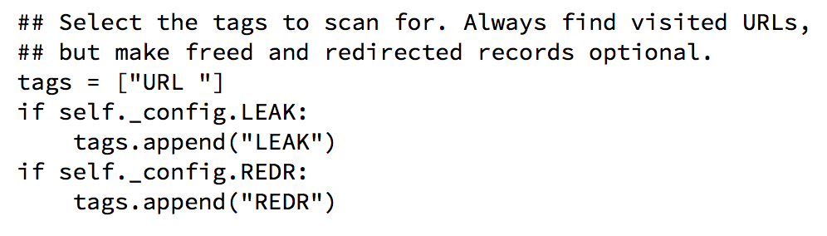
Firefox and Chrome History
Core Volatility has iehistory plugin
Searches for “tags” in history record
Why
Why not a Firefox or Chrome plugin?

Slide 12
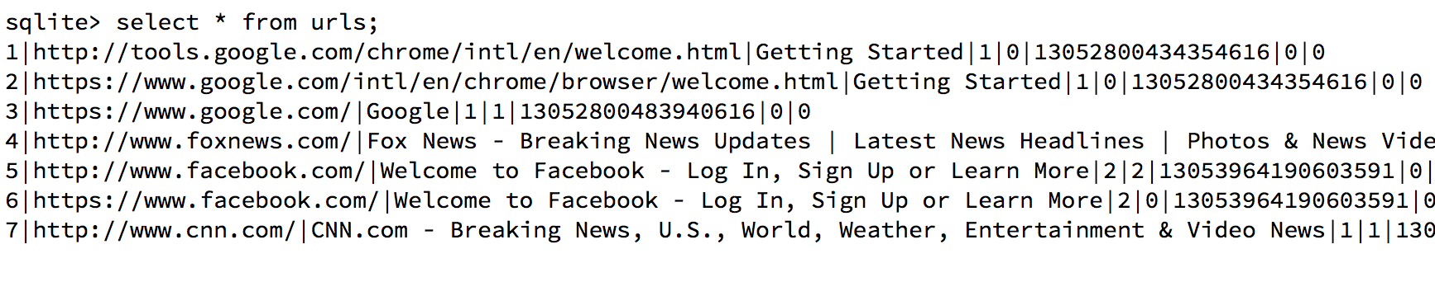
Firefox and Chrome History
Store history in SQLite database
What does the data look like in memory?
Can’t just find start of sqlite file (bigger than a page)
How to identify records in the middle of the file?

Slide 13
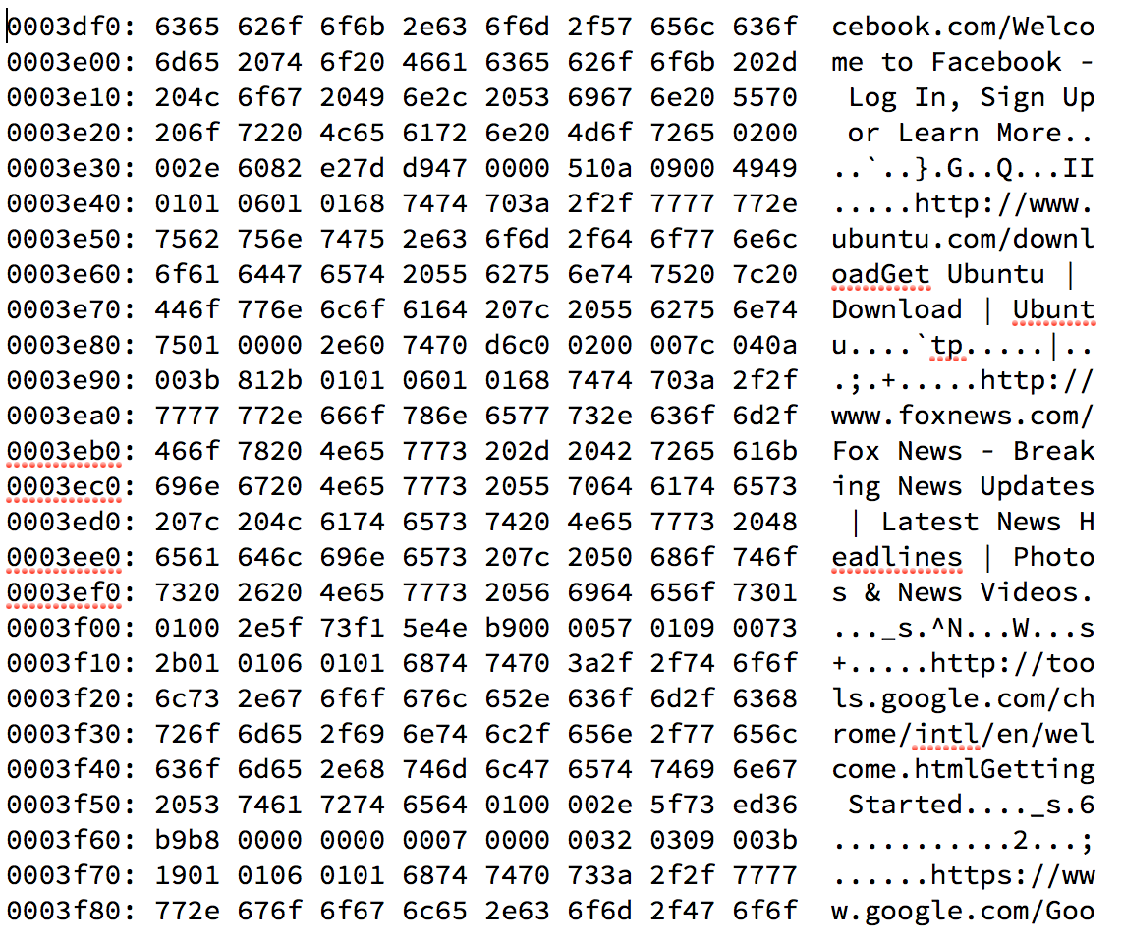
Firefox and Chrome History

Slide 14
Firefox and Chrome History
0101060101

Slide 15
Firefox and Chrome History
0101060101
Field sizes
6 => 8 ?

Slide 16
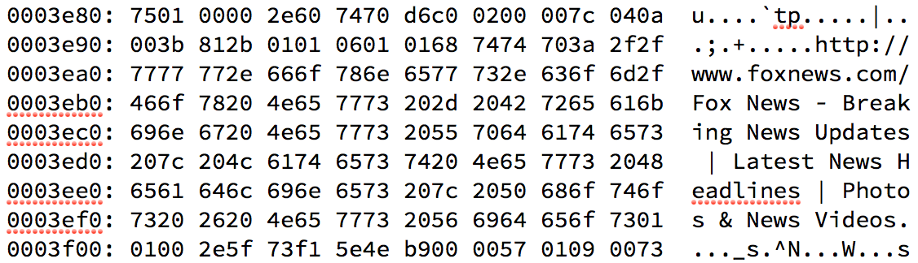
Firefox and Chrome History
String Length?
0x3b == 59, len(http://www.foxnews.com/) == 23
0x812b == 33067, len(“title”) = 79
WTF?
Two things going on

Slide 17
Firefox and Chrome History
Other one byte values => String Length?
0x3b == 59, len(http://www.foxnews.com/) == 23
(59 - 13) = 46, 46 / 2 = 23
0x812b ==33067, len(“title”) = 79
Split into two bytes
0x81 = 129, 0x2b = 43, 129 + 43 = 172
(172 - 13) = 159, 159 / 2 = 79.5
Variable Length Integer Format
http://www.evolane.com/support/manuals/shared/manuals/tcltk/sqlite/fileformat.html#varint_format

Slide 18
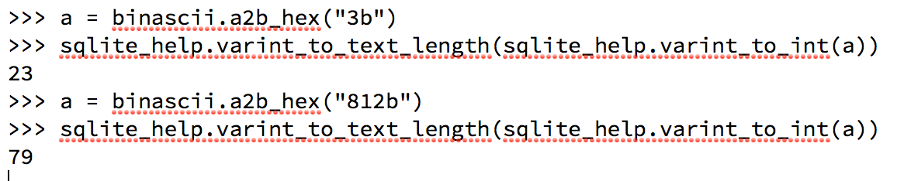
Firefox and Chrome History
Variable Length Integer Format
A variable-length integer or "varint" is a static Huffman encoding of 64-bit twos-complement integers that uses less space for small positive values. A varint is between 1 and 9 bytes in length. The varint consists of either zero or more byte which have the high-order bit set followed by a single byte with the high-order bit clear, or nine bytes, whichever is shorter. The lower seven bits of each of the first eight bytes and all 8 bits of the ninth byte are used to reconstruct the 64-bit twos-complement integer. Varints are big-endian: bits taken from the earlier byte of the varint are the more significant and bits taken from the later bytes.
1 - 9 bytes to store 64-bit number
Efficient for storing lots of small numbers
0x812b == 1000 0001 0010 1011 => 000000 10101011 == 171
(171 - 13) = 158, 158 / 2 = 79

Slide 19
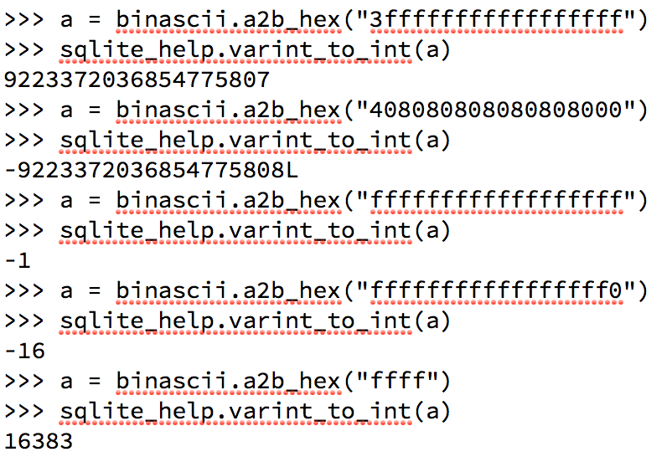
Firefox and Chrome History
64-bit integer limits
9223372036854775807 == 0x7fffffffffffffff
-9223372036854775808 == 0x8000000000000000
-1 == 0xffffffffffffffff
Negative number: To make 1st bit 1, must use all 9 bytes

Slide 20
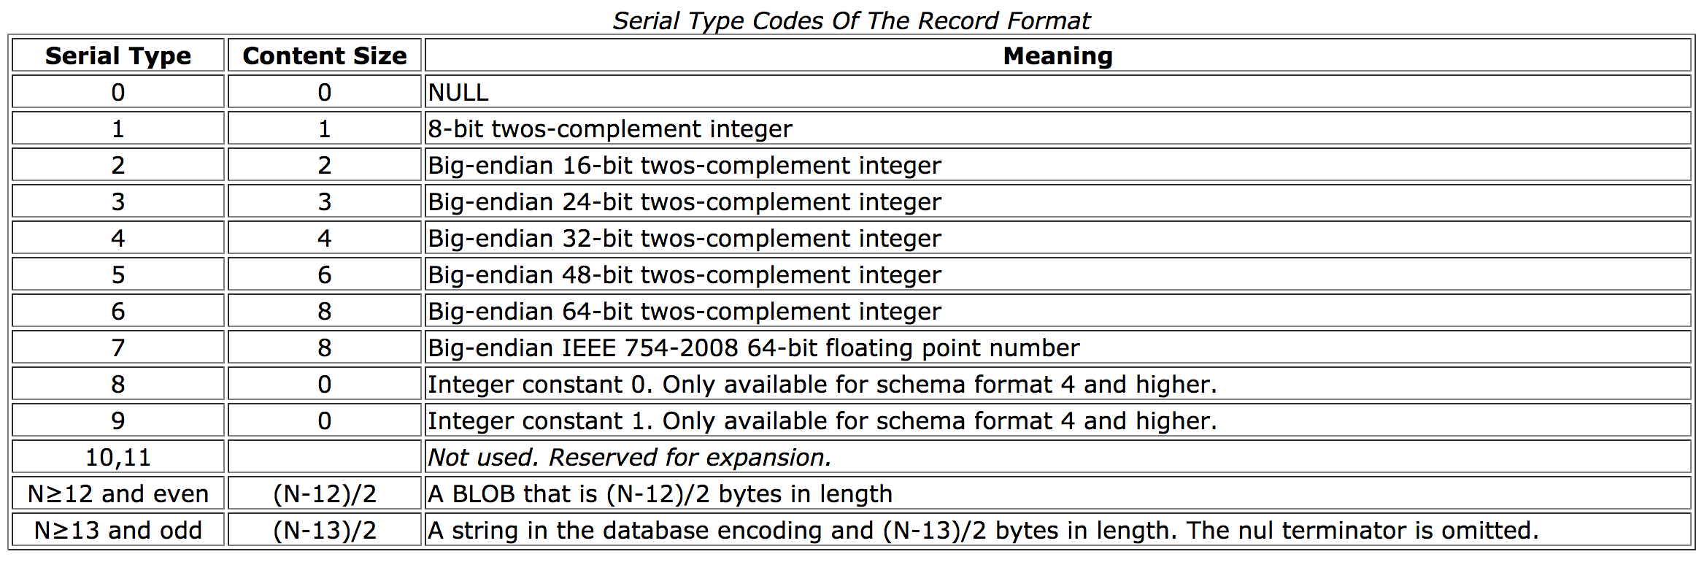
Firefox and Chrome History
Why subtract 13 and divide by 2?
odd * 2 = even; even * 2 = even;
add 12 for BLOB; add 13 for string
https://www.sqlite.org/fileformat.html

Slide 21
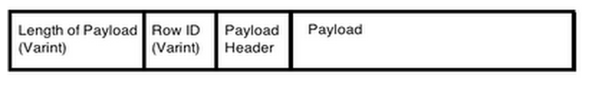
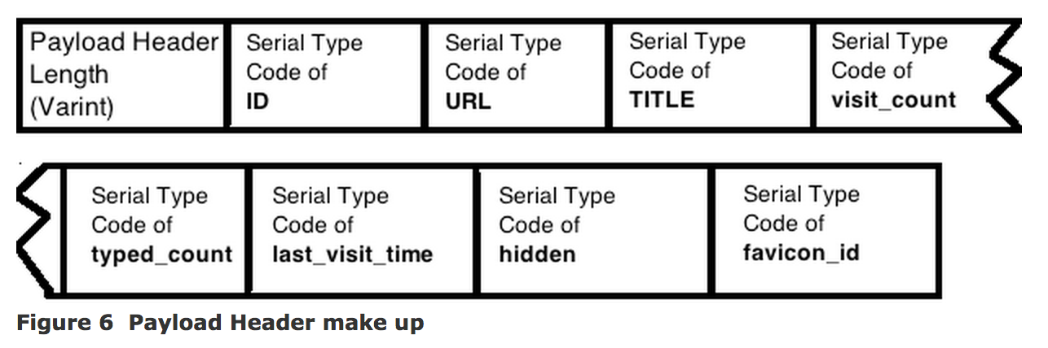
Firefox and Chrome History
Wish I had found this sooner:
http://forensicsfromthesausagefactory.blogspot.in/2011/05/analysis-of-record-structure-within.html

Slide 22
Firefox and Chrome History

Slide 23
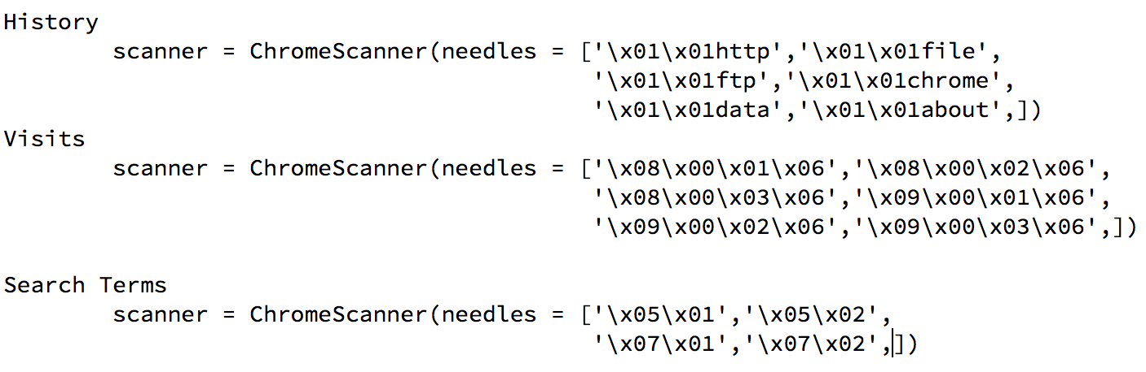
Firefox and Chrome History
“Needles” from some plugins
Extract other fields backwards/forwards

Slide 24
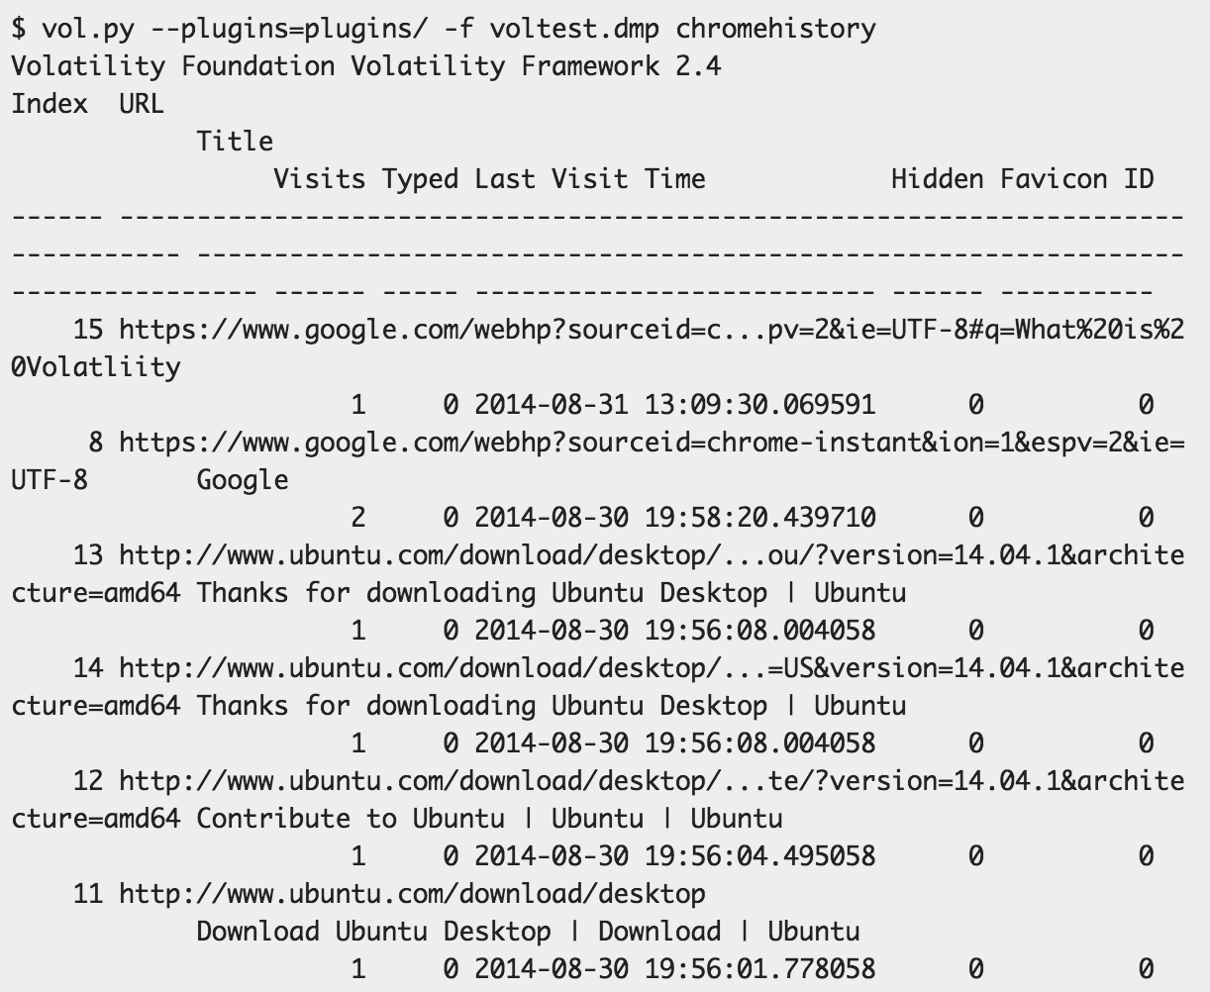
Firefox and Chrome History

Slide 25
Firefox and Chrome History
Chrome Plugins
chromehistory
chromevisits
chromesearchterms
chromedownloads
chromedownloadchains
chromecookies
Firefox Plugins
firefoxhistory
firefoxcookies
firefoxdownloads

Slide 26
Plugins Submitted
Office Trust Records
Java IDX Parser
Firefox and Chrome History
SSDeep-based Plugins

Slide 27
SSDeep Based Plugins
Original idea
Locate source of injected code
Search memory dump for code
Trace it back to another file
Won’t work if code isn’t copied directly
Implemented with ssdeepscan plugin
Realized it could be used for whitelisting

Slide 28
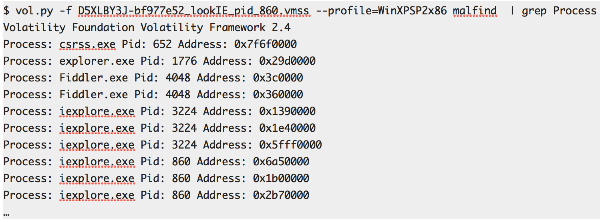
SSDeep Based Plugins
Malfind on http://malware.dontneedcoffee.com/2014/08/angler-ek-now-capable-of-fileless.html

Slide 29
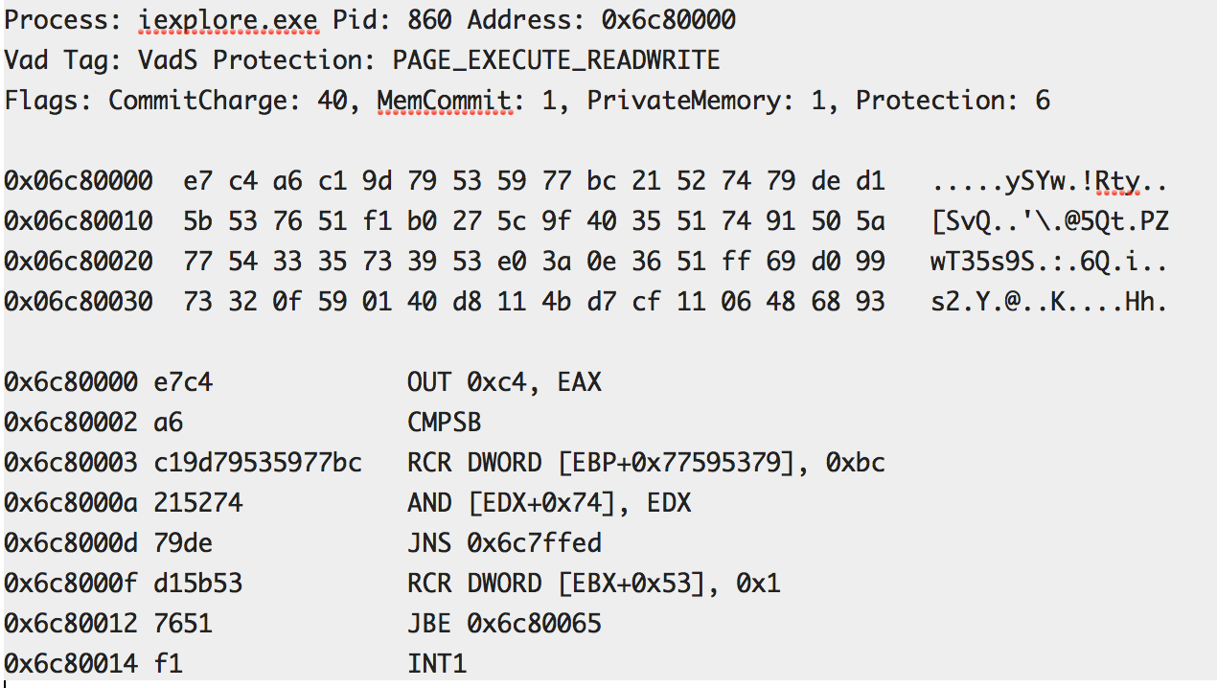
SSDeep Based Plugins
Dump of one section (XORed)

Slide 30
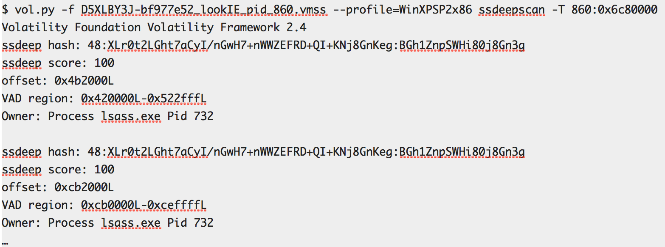
SSDeep Based Plugins
Fuzzy hash page at 0x6c80000 in PID 860 and search rest of memory

Slide 31
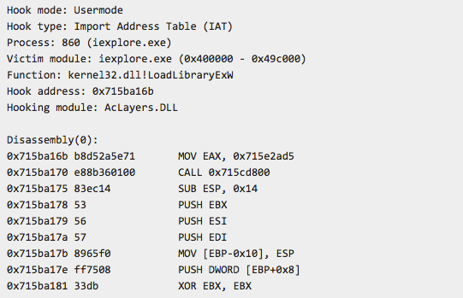
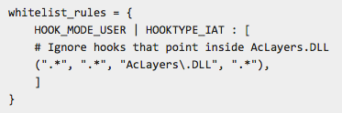
SSDeep Based Plugins
apihooksdeep and malfinddeep whitelists

Slide 32
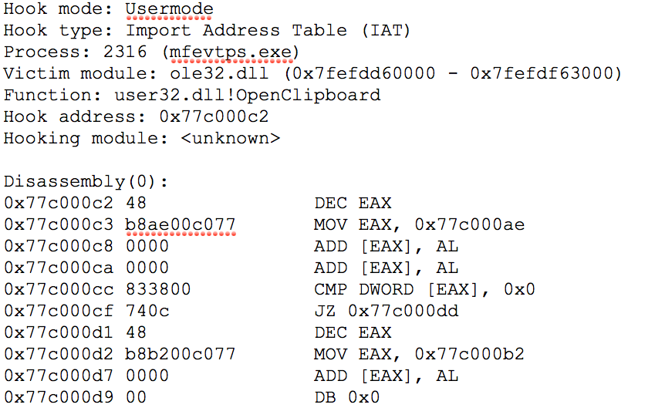
SSDeep Based Plugins
What if hooking module unknown?
Seen in security tools (AV) and malware

Slide 33
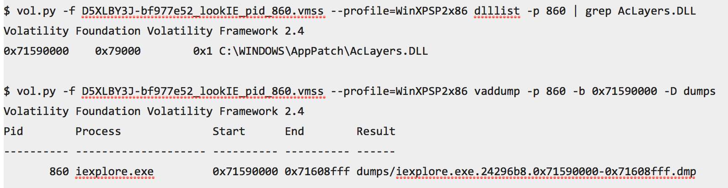
SSDeep Based Plugins
Find the DLL or VAD address
where file is mapped
where shellcode starts
Dump the DLL of VAD

Slide 34
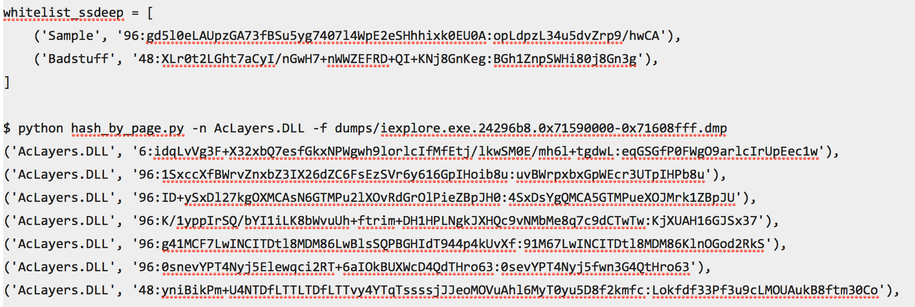
SSDeep Based Plugins
Add hashes to config in apihooksdeep.py or malfinddeep.py

Slide 35
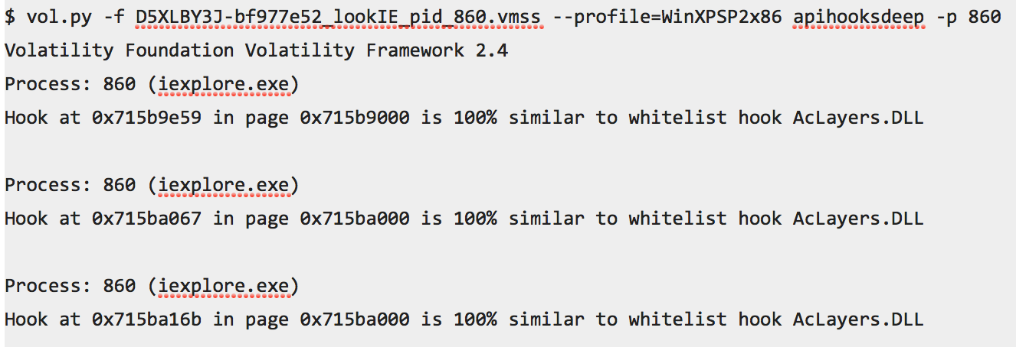
SSDeep Based Plugins
Run apihooksdeep plugin

Slide 36
Questions/Comments?
Code on GitHub:
https://github.com/superponible/volatility-plugins
More details in blog posts:
http://superponible.com
Contact:
dave@superponible.com
@superponible

